Slide 1



Stammering Awareness
Alex Ford, Beth Loveday & Sarah Taylor
Specialist Stammering Service
Swindon

Slide 2
Aims
What is Stammering?
Early Stammering and developmental non fluency
Impact of stammering
Supporting children in your setting/ school
Specialist Stammering Service: Swindon
The Fluency Trust Charity
2

Slide 3
What is Stammering?
Stammering is the disruption of speech fluency.
Stammering will vary from one child to another
A child who is stammering may show some of all of the following features
Repetitions
Prolongations
Blocking
Concomitant
Movements
Avoidance

Slide 4
Lets find out more about stammering….
Stammering and Stuttering mean the same thing
True
False
Stammering is caused by anxiety
True
False
Stammering can run in families
True
False
Stammering recovery often occurs as the child gets older
True
False
Parents can cause stammering
True
False
Click here to continue
4

Slide 5

Well Done!
The answer is TRUE
Stammering and Stuttering mean exactly the same thing. Stammering is the term we use in the UK and Stuttering is used more in America.
We tend to use the term the family or young person have chosen to use
Click here to continue

Slide 6

Sorry!
The answer is TRUE
Stammering and Stuttering mean exactly the same thing. Stammering is the term we use in the UK and Stuttering is used more in America.
We tend to use the term the family or young person have chosen to use
Click here to continue

Slide 7
Well Done!
The answer is FALSE
In the media stammering is often portrayed as being caused by anxiety or nerves. In actual fact people who stammer are no more or less anxious/ nervous than so called ‘fluent speakers’.
Stammering is what we call a ‘neurodevelopmental condition’
This means it is neurological (it happens in how messages are sent in the brain) and developmental (so often happens from a very young age when children first learn to talk)
Click here to continue

Slide 8
Sorry!
The answer is FALSE
In the media stammering is often portrayed as being caused by anxiety or nerves. In actual fact people who stammer are no more or less anxious/ nervous than so called ‘fluent speakers’.
Stammering is what we call a ‘neurodevelopmental condition’
This means it is neurological (it happens in how messages are sent in the brain) and developmental (so often happens from a very young age when children first learn to talk)
Click here to continue

Slide 9
Well Done!
The answer is TRUE
Stammering can run in families in some cases but not all.
Stammering occurs across all cultures and social groups
We also know more boys stammer than girls
Click here to continue

Slide 10
Sorry!
The answer is TRUE
Stammering can run in families in some cases but not all.
Stammering occurs across all cultures and social groups
We also know more boys stammer than girls
Click here to continue

Slide 11
Well Done!
The answer is TRUE
Stammering recovery often occurs as a child gets older.
Almost half of children between the ages of 2-7 years old can go through a phase of developmental non-fluency (We’ll cover this soon)
According to the British Stammering Association or STAMMA around 8% of children stammer and 3% of adults do.
Many children will find they no longer stammer as they get older. Positive changes can still be made through Teen years and adulthood.
Click here to continue

Slide 12
Sorry!
The answer is TRUE
Stammering recovery often occurs as a child gets older.
Almost half of children between the ages of 2-7 years old can go through a phase of developmental non-fluency (We’ll cover this soon)
According to the British Stammering Association or STAMMA around 8% of children stammer and 3% of adults do.
Many children will find they no longer stammer as they get older. Positive changes can still be made through teen years and adulthood.
Click here to continue

Slide 13
Well Done!
The answer is FALSE
There is no evidence that parents cause stammering.
We do know that a child’s environment can influence how they speak.
Click here to continue

Slide 14
Sorry!
The answer is FALSE
There is no evidence that parents cause stammering.
We do know that a child’s environment can influence how they speak.
Click here to continue

Slide 15
Early Stammering & Developmental Non-Fluency
Child’s Abilities
My language skills e.g. able to use the words I want to and put them in to sentences.
Demands
I need to tell mummy something very important right now
Starting a new school
Busy day at nursery
I have confidence to talk to people I know

Slide 16

Example of Developmental Non-fluency
Example of Early Stammering
Features you might notice
Whole word or phrase repetitions
Pausing or using ‘um’ ‘err’
No evidence of tension of struggle
Happily communicates and is unaware of non-fluency
Child’s speech and language is not held back.
Features you might notice
Sound or part word repetitions
Prolonging sounds or blocking
Stammering is there most days
The child is aware of stammering
Tension or struggle
Changing or giving up on words
Other Speech and Language needs
Poor co-ordination skills
It can be very difficult to decide whether a child is showing signs of early stammering. If you are not sure or are worried please contact us.

Slide 17
Impact of Stammering
Discuss or jot down ideas of how you think stammering could impact in the following areas….
Social
Emotional
Behaviour
Learning
You may have noted things like
Ability to make friends
Being bullied (around 80% of children who stammer report bullying)
Taking social opportunities like meeting friends, ordering food, visiting the shops
You may have noted things like
Impact on self-esteem
Confidence
Loneliness
Anxiety
Frustration
You may have noted things like
Withdrawal
Staying quiet
Physical or challenging behaviours
You may have noted things like
Joining in groups
Being able to assess knowledge when staying quiet
Delivering presentations
Oral exams

Slide 18
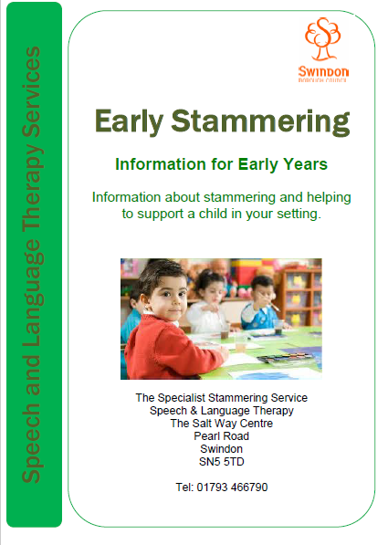
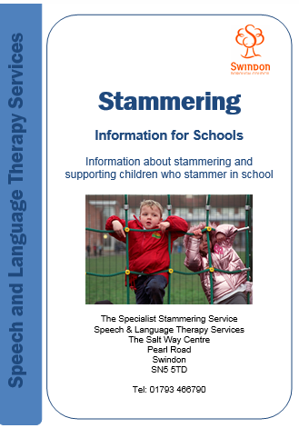


Supporting a child or young person who stammers
Consider for a moment what you already do or could do to support a child or young person who stammers in your setting or school?
You can access our all our advice leaflets at www.swindonspeechandlangaugetherapy.wordpress.com

Slide 19
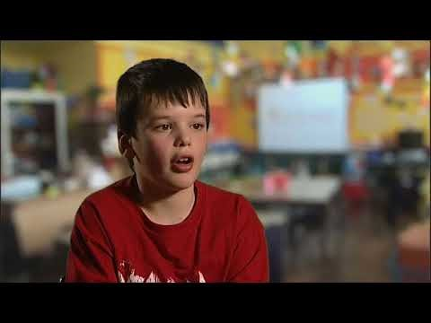
Supporting a child or young person who stammers

Slide 20
What helps?
Give time- reduce time pressure, pause and slow your own speech.
Look out for any bullying and teasing and address this. 80% of children who stammer are teased or bullied.
Make sure information is passed on when the child has a new teacher.
Focus on what the child has to say- give eye contact.
Talk to the child one to one- Be flexible with challenging tasks, reduce demands on difficult days
Give choices- build skills gradually, help develop confidence
Encourage turn taking skills

Slide 21
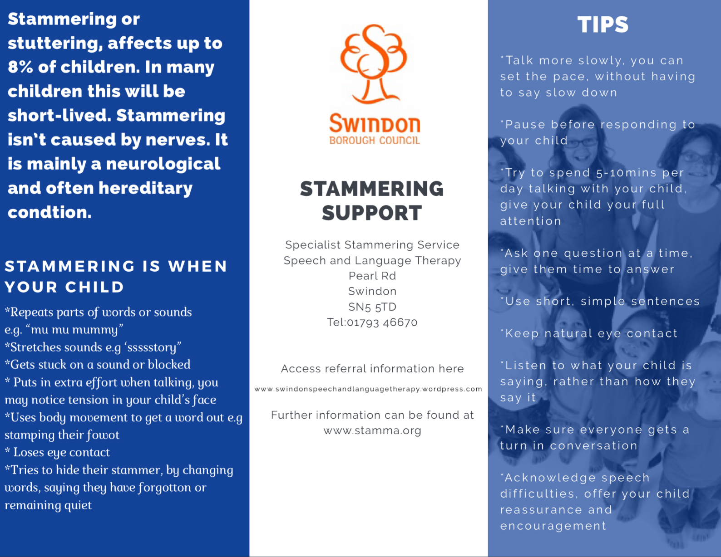
Referring to Speech and Language Therapy
If you are concerned about stammering or a parent is worried about stammering please refer to our service.
Early intervention is really important!
www.swindonspeechandlanguagetherapy.wordpress.com
You can find our referral form on our website and a general information flyer that can be given to parents.
Please highlight Stammering on your referral form.
You do not need to complete BRISC (unless there are additional concerns).

Slide 22
The Swindon Specialist Stammering Service
Meet the team
Here in Swindon we are lucky to have a well established specialist stammering service.
Following a recent CQC inspection in 2017, they described the stammering service as outstanding.

Slide 23
The Swindon Specialist Stammering Service

Slide 24
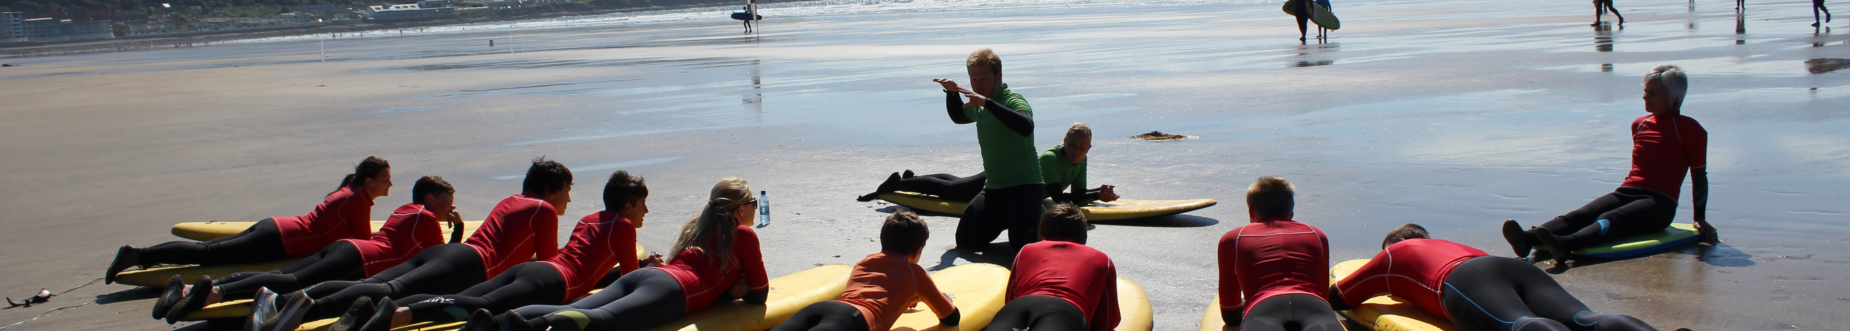
The Fluency Trust Residential Courses
In partnership with The Fluency Trust Charity we are able to run residential courses for young people who stammer. Combining outdoor adventure activities and intensive group speech therapy.
Children and young people between the ages of 10-17 years old can attend
Young people from all over the country come on these courses and for Swindon children this fantastic experience is totally free.
For more information please visit www.thefluencytrust.org.uk or contact Alex, Beth or Sarah

Slide 25
Thank you for completing this workshop
We appreciate your feedback.
Please complete the following questions and copy and paste to gsmith@swindon.gov.uk to receive your certificate.
Stammering Awareness Session: Feedback
Name | Date
Job Title/ Place of Work
Place an ‘X’ in the box that most represents how you feel. |  | Strongly agree | Agree | Neutral | Disagree | Strongly disagree
This training will be useful to your work
The course presentation was clear & informative
The course objectives were met
I feel confident supporting children/ young people who stammer
Most useful thing about this workshop
Least useful thing about this workshop
Things I will do differently now on
Additional comments

