Slide 1
MeLSA
The essence – MeLSA in a nutshell
MeLSA builds capacity of schools to support the learning needs of their pupils.
MeLSA delivers evidence based research in an accessible and interactive manner to ensure participants have a sound understanding of the psychology of learning.
MeLSAs gain the skills to assist a child or young person to be a more skilled and independent learner.

Slide 2
The essence – MeLSA in a nutshell
Fruits are mastered skills
Buds and flowers
need tailored support from a more able adult to develop into fruits
MeLSAs use mediating skills to help the child develop skills for independent learning.

Slide 3
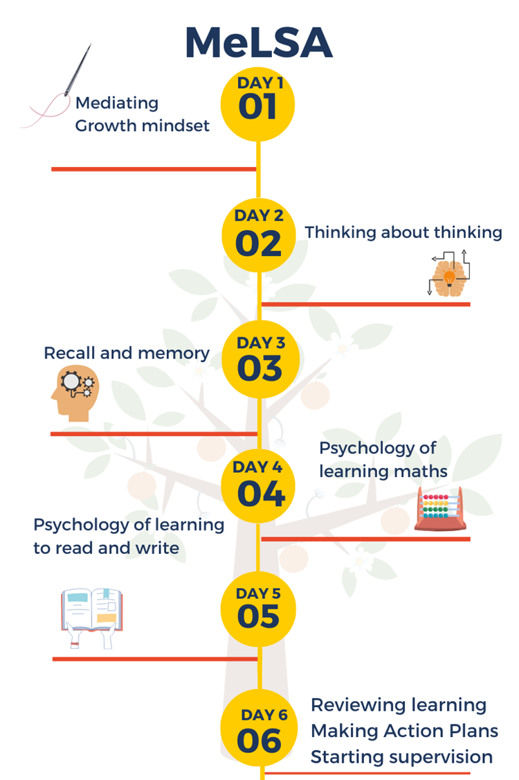
Training outline

Slide 4
Feuerstein – mediating
Dweck (2015, 2010, 2017)
Self-regulated learning (Schunk, 2008; Zimmerman, 1989)
Executive functions (Diamnond, 2013)
Cognitive Load, (Sweller, 1988)
Multi-store model of memory and working memory model (Atkinson & Shiffrin, 1968)
Levels of processing theory (Craik & Lockhart, 1972)
Graves, 2018
Solity & Vousden (2009) – ‘little and often’; Precision teaching (Solity et al., 2016)
Developing fluency (Rasinski, 2014)
Paired reading (Topping, 2006)
MAP (Newton & Wilson, 2016)
Target, monitoring and evaluation (TMI) Dunsmuir, Brown, Iyadurai & Monsen (2009)

Slide 5
MeLSA outcomes & EEF
1. Understand importance of mindset and be able to explore this with pupils.
2. Understand a model of learning and be able to investigate a pupil's learning skills.
3. Begin understanding the four aspects of mediating; thinking skill, content, language, complexity
4. To understand what the executive function skills and metacognitions are.
5. To understand how these impact learning.
6. To know how to mediate and change a task to help a child when there are thinking skill difficulties.
7. To develop an understanding of the concepts that make up ‘memory’ focusing on cognitive load theory.
9. To explore different ways in which our memory can be unhelpfully challenged in the classroom.
9. To know how to mediate and change a task to reduce cognitive load and maximise recall.
10. Understand how a pupil learns number skills.
11. To know how to support the learning of key number skills
12. To investigate and support a child's number skill development through mediating and changing a task.
13. Understand how a pupil learns to read.
14. Know how to investigate and mediate to support a child’s reading skills.
15. Use knowledge gained to support CYP with literacy difficulties.
16. To revisit mediating principles generally and specifically to each of the above sessions.
17. To plan next steps for development of MeLSA skills.

Slide 6
Thank you
www.swindon.gov.uk
Contacts:
adenham@swindon.gov.uk
shorgan@swindon.gov.uk

