Slide 1
Introduction to Healthwatch Swindon Swindon – Transitions Roadshow Josephine Fliski

Slide 2
What does Healthwatch Swindon do?
We consult with the public. Report and make recommendations on how local health and social care services can improve.
We ensure local people are involved in making those recommendations
We provide information on local services.
Before COVID we did ‘enter and view’ visits to health and social care facilities. We now do ‘virtual visits’ instead

Slide 3
Part of a national network in England
Healthwatch England is the independent national champion for people who use health and social care services. It aims to make sure that those running services, and the government, put people at the heart of care.
It supports and advises Local Healthwatch throughout England.

Slide 4
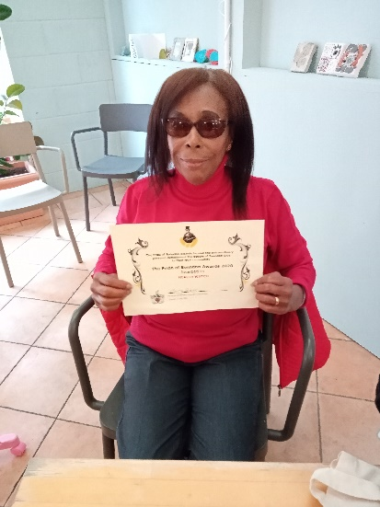
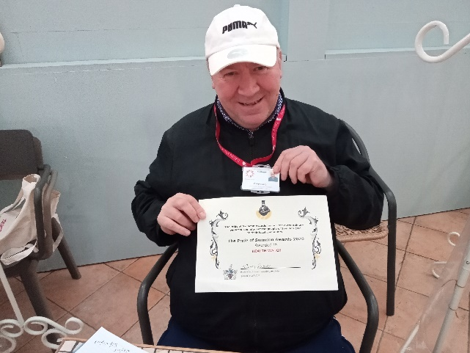
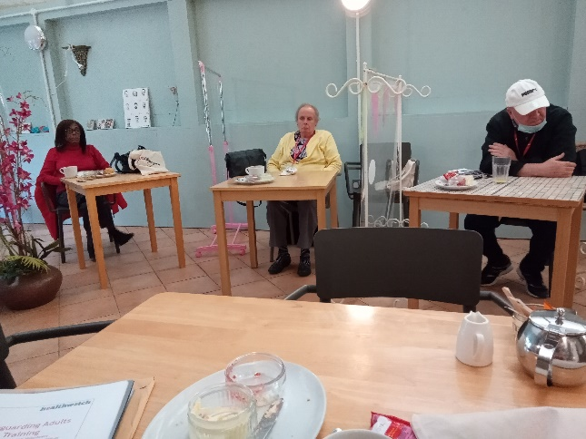
Our volunteers
Volunteers are at the heart of what we do
We have 23 volunteers supporting the work we do – and we could not do it without them

Slide 5
Contacts
We are based at Sanford House, Sanford Street, SN1 1HE
T: 01793 497777
E: info@healthwatchswindon.org.uk
W: www.healthwatchswindon.org.uk
@HealthwatchSwin

