Slide 1


Building Bridges – Supported Employment
Phil Wood
Keyworker
21st Sept 2021
Our Funding
The Building Bridges programme is jointly funded by The National Lottery Community Fund and the European Social Fund.
Transitions Roadshow September 2021

Slide 2
About us……
The Building Bridges programme supports people across Swindon and Wiltshire who are facing significant challenges in being able to develop their skills, access education or move towards the world of work. If you need help and support to find work or access skills training or education, you could really benefit from taking part in the programme.
If you are looking to get into work or education, the programme can help you to develop the skills and qualifications you need and address the practical issues such as transport costs, confidence and help with childcare.
Transitions Roadshow September 2021

Slide 3
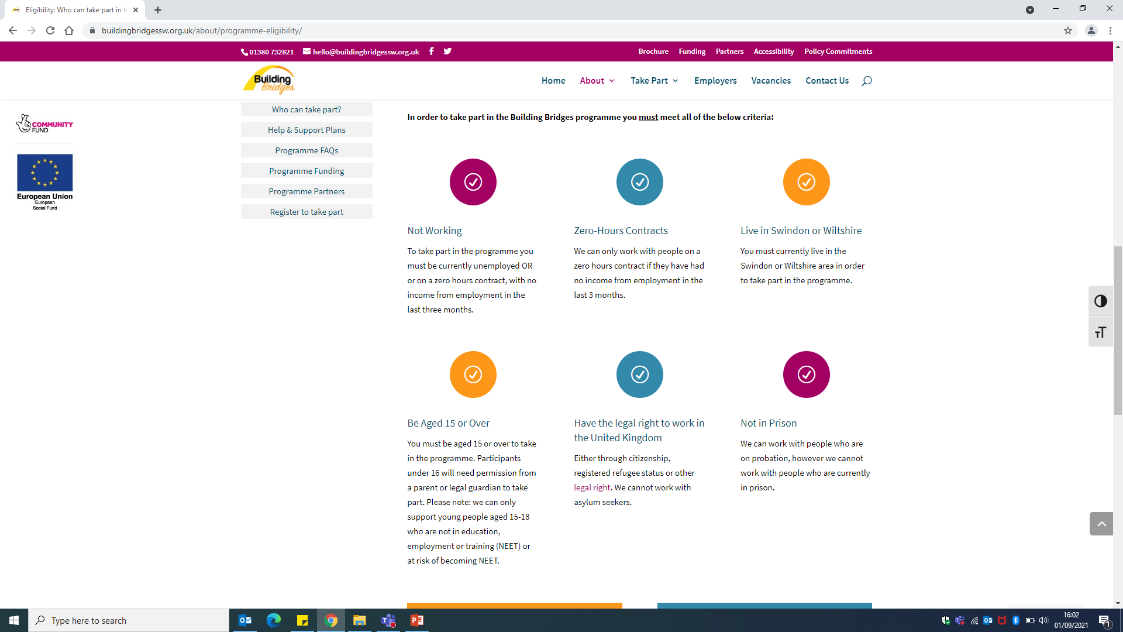
Eligibility
Not Working
Zero-Hour Contracts
Live in Swindon or Wiltshire
To take part in the programme you must be currently unemployed OR economically inactive.
We can only work with people on zero hours contract if they have had no income from employment in the last 3 months.
You must currently live in the Swindon or Wiltshire area in order to take part in the programme.
Be Aged 15 or Over
Have the legal right to work in the United Kingdom
Not in Prison
You must be aged 15 or over to take part in the programme. Participants under 16 will need permission from a parent or legal guardian to take part. Please note: we can only support young people aged 15-18 who are not in education, employment or training (NEET) or at risk of becoming NEET.
Either through citizenship, registered refugee status or other legal right. We cannot work with asylum seekers.
We can work with people who are on probation, however we cannot work with people who are currently in prison.
Transitions Roadshow September 2021

Slide 4
Further information can be found at:
https://buildingbridgessw.org.uk/
Or get in touch by emailing
supportedemployment@swindon.gov.uk
Transitions Roadshow September 2021

