Slide 1
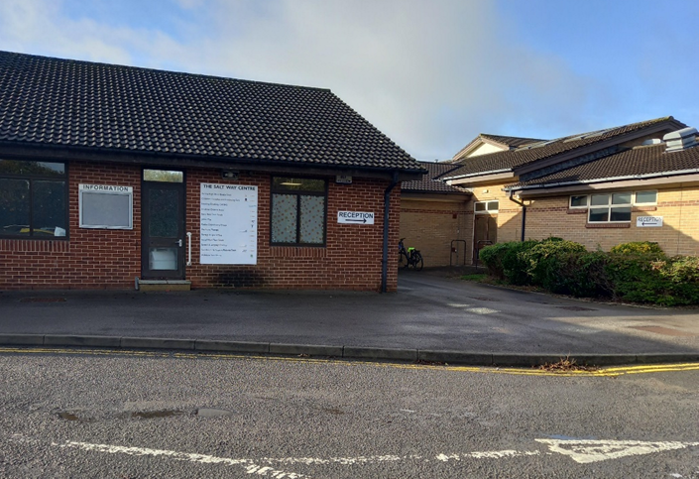
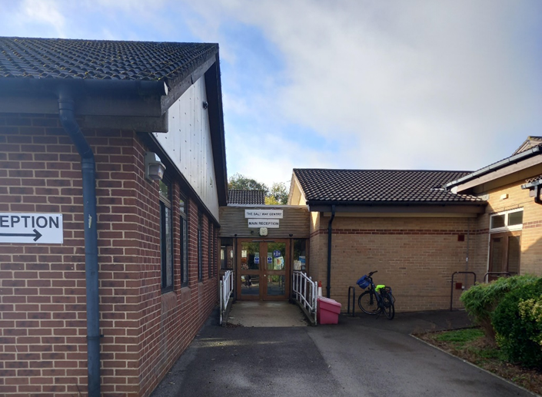
When it is time to come to Speech and Language Therapy, I will go to the Salt Way Centre.

Slide 2
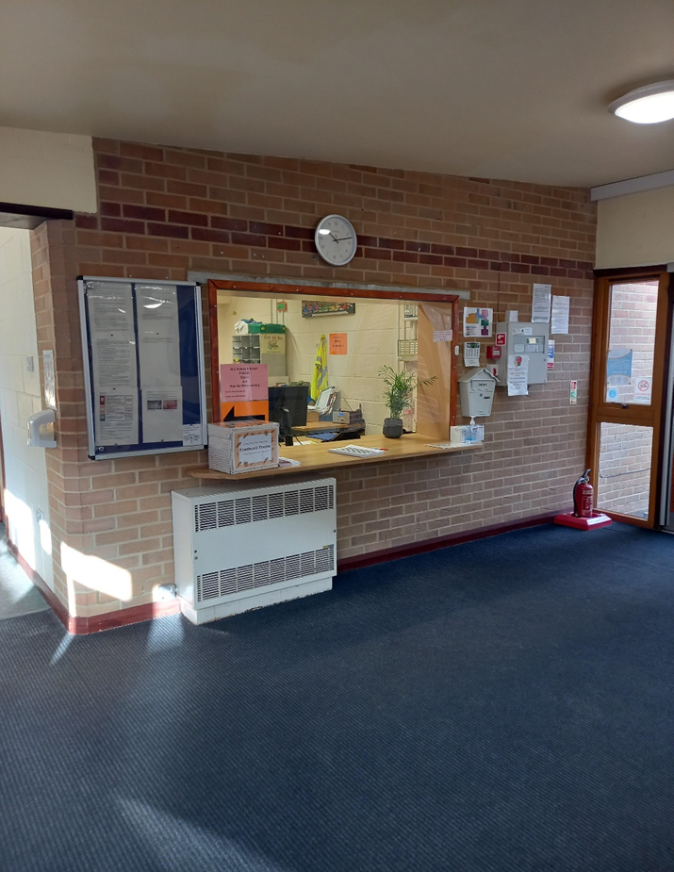
I will go to the reception desk.

Slide 3
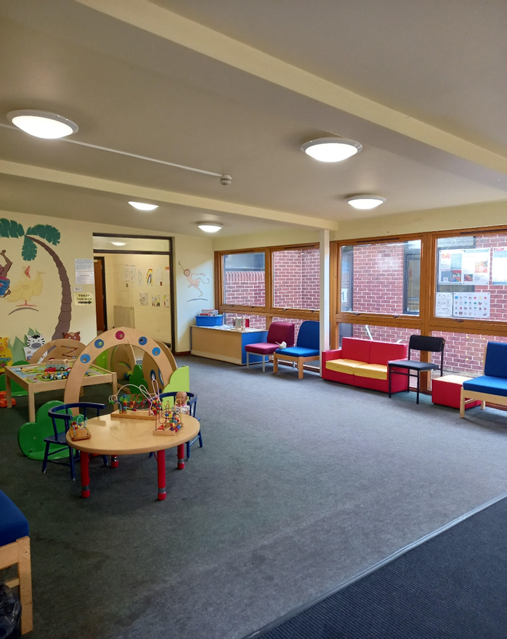
I will wait in the waiting area.

Slide 4
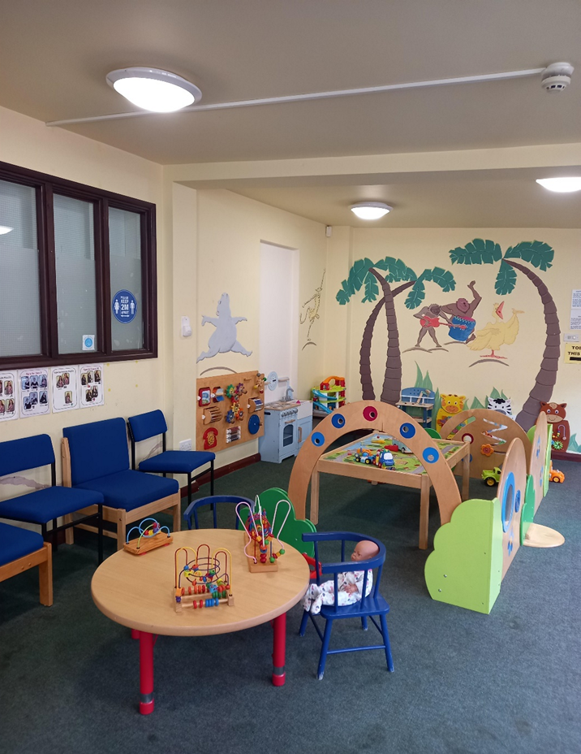
There will be some toys to play with whilst we wait.

Slide 5
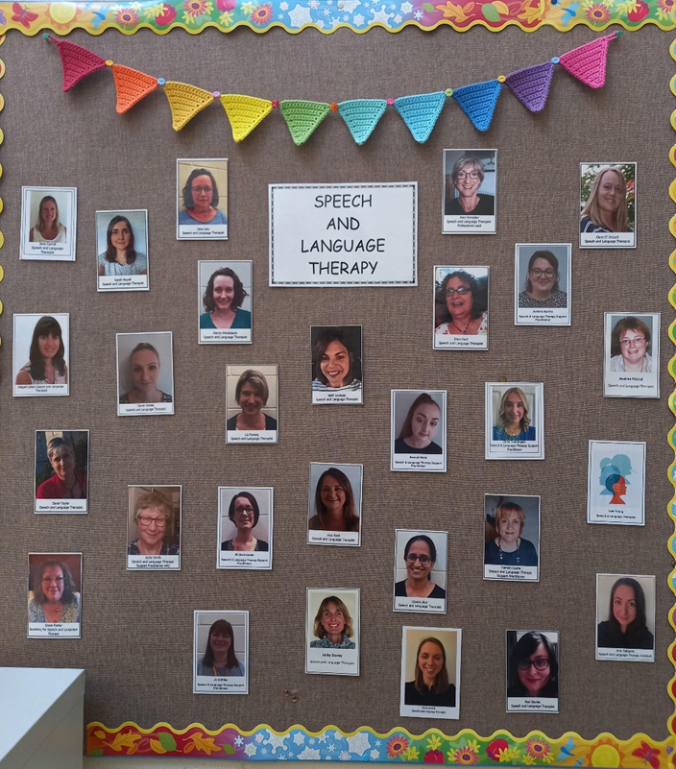
The Speech and Language Therapist will come and say hello.

Slide 6
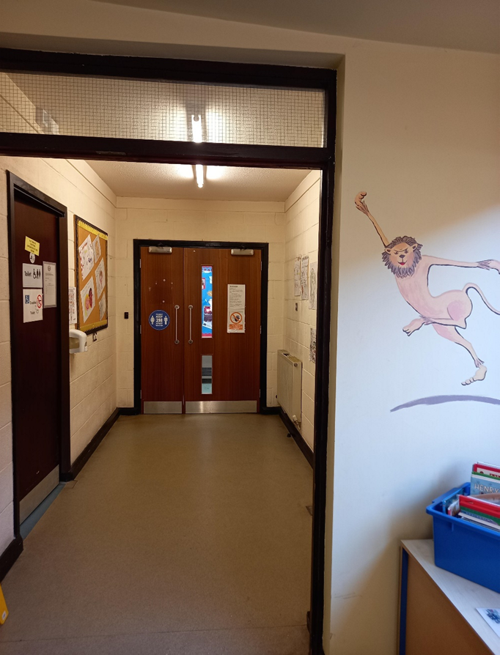
We will go to their room.

Slide 7
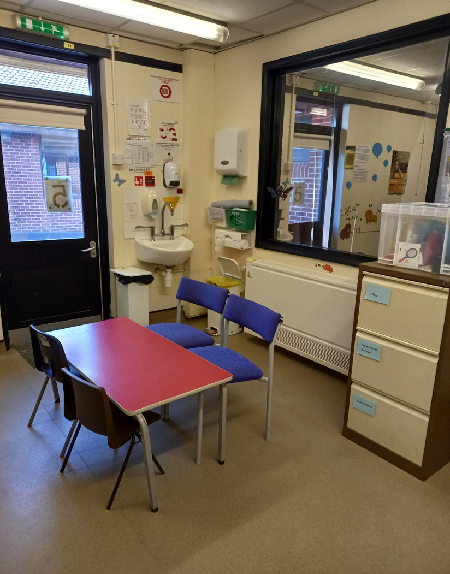
At Speech and Language Therapy, there will be toys and games to play with.

Slide 8
When we are finished, I will go back to the waiting room.

Slide 9
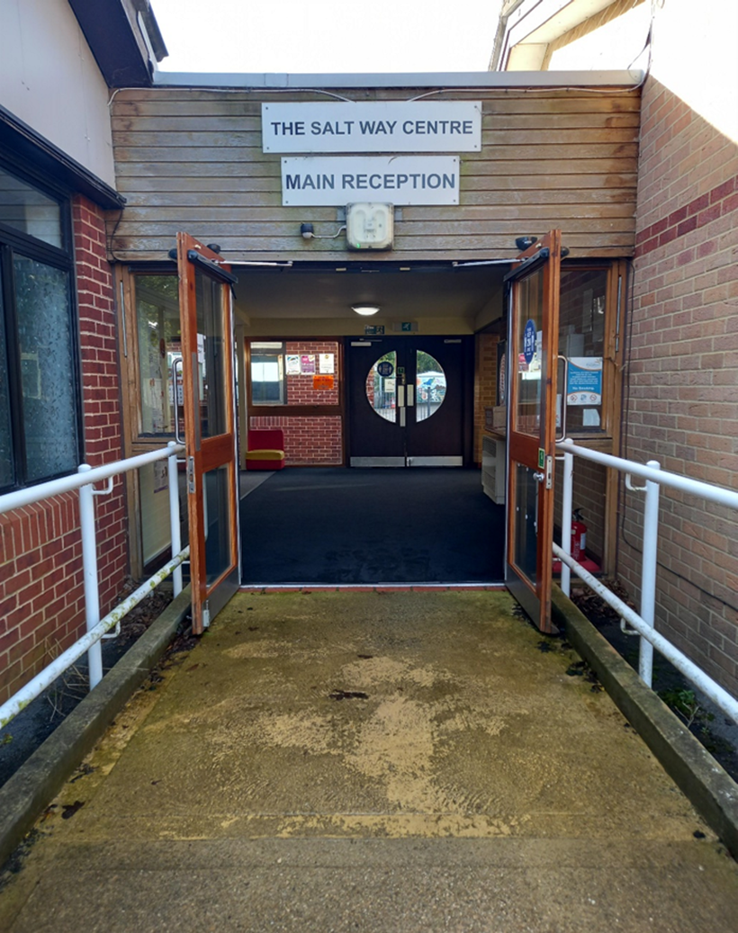
I will go home. I might come back to Speech and Language Therapy again another day.

