Slide 1

The importance of regular school attendance
Andrea Packer
Lead Education Welfare Service

Slide 2
What to we know about attendance
We know there is a refreshed approach to improving school attendance from the Department for Education;
We know that the Children’s Commissioner’s Office is raising awareness of the importance of improving school attendance;
Swindon Borough Council is also prioritising school attendance over this academic year by introducing various initiatives, such as an attendance campaign and a revised attendance strategy.

Slide 3
Outline of our session today
Why improving attendance is so important;
What this means for parents and carers;
What this means for schools;
What this means for Swindon Borough Council;
What is good attendance?
Accessing support as a parent/carer;
Opportunity for questions.

Slide 4
National picture
What we do know is that in autumn 2021 there were 1.7 million children persistently absent from school, meaning that they missed at least seven days of school in the term
98,000 children severely absent, meaning that they missed at least 35 days of school in the term.
Vulnerable children were more likely to be absent nationally: 33.6% of pupils receiving Free School Meals (FSM) were persistently absent in autumn 2021, compared to 20% of pupils not in receipt of FSM.

Slide 5
Why is improving attendance so important?
School attendance is crucially important for children and young people’s education, their wellbeing, their safety, and their future prospects.
Children who regularly miss school may fall behind in their work which can have an impact on their grades. They will also miss out on fun opportunities to learn new things and spend time with friends. Parents can also be assured that when children are in school, they are safe.

Slide 6
Some of the research about attendance
Research by Universities UK and the DFE indicates that children with poor attendance are 5 times less likely to achieve five strong passes at GCSE , preventing them from going on to Further Education, Higher Education or into employment;
MOJ report – for the most vulnerable pupils, regular attendance is also an important protective factor and the best opportunity for needs to be identified and support provided.
Children who missed the second, third and fourth day of a new term were predicted an overall absence of almost 45%, or 31 days across the term, significantly more than their peers who attended those first few days. Secondly, whilst Fridays are the most common day for children to be absent, it is actually those children who miss mid-weekdays, Tuesday-Thursday, who are more likely to be habitually absent from school.

Slide 7
Absence and Attainment at Key Stage 2 and Key stage 4 in 2018/2019 (DfE)
The pupils with the highest attainment at the end of key stage 2 and key stage 4 have higher rates of attendance over the key stage compared to those with the lowest attainment.
At KS2, pupils not meeting the expected standard in reading, writing and maths had an overall absence rate of 4.7%, compared to 3.5% among those meeting the expected standard.
Moreover, the overall absence rate of pupils not meeting the expected standard was higher than among those meeting the higher standard (4.7% compared to 2.7%).
At KS4, pupils’ not achieving grade 9 to 4 in English and maths had an overall absence rate of 8.8%, compared to 5.2% among those achieving grade 41.
The overall absence rate of pupils not achieving grade 9 to 4 was over twice as high as those achieving grade 9 to 5 (8.8% compared to 3.7%).
For care-experienced children overall absence rates 20/21 were 9.1%, for children in need absence rates were 13.85 and for children on protection plans absence rates were 17.6.

Slide 8
What does this mean for parents and carers?
The law entitles every child of compulsory school age to an efficient, full-time education suitable to their age, aptitude and any special educational need they may have.
Where parents decide to have their child registered at school, they have an additional legal duty to ensure their child attends that school regularly.
This means their child must attend every day that the school is open, except in a small number of allowable circumstances such as being too ill to attend or being given permission for an absence in advance from the school.

Slide 9
What does this mean for schools?
All schools have a continuing responsibility to proactively manage and improve attendance across their school community;
Consistently promote the benefits of good attendance at school;
Set high expectations for every pupil;
Communicate clearly with parents and pupils;
Have a clear school attendance policy which everyone understands;
Build strong relationships with families, listen to and understand barriers to attendance and work with families to remove them.

Slide 10
What does this mean for Swindon Borough Council?
Along with our safeguarding partners and other partners have a crucial role in supporting pupils to overcome barriers;
Ensure children can access the full-time education that they are entitled to;
Facilitate wider support needed by individual families and schools to overcome barriers in the short term;
Deliver core functions to schools – attendance support team, communication and advice, support meetings, multi-disciplinary support for families and legal intervention.

Slide 11
Do you know what your child's attendance is?
Do you know what it means?
?

Slide 12

This is Simone. She is in Year 7 and has 90% attendance
Is that good?
What does this mean?

Slide 13
Simone thinks this is pretty good, so do her parents. Are they right?
90% attendance = ½ day missed every week!!
Mon | Tue | Wed |  | Thur | Fri
 |  | ?
Absent half a day every week

Slide 14
Looking a little closer
1 school year at 90% attendance = 4 whole weeks of lessons MISSED!!!
38 school weeks
Sept July
 | ?
Absent for 4 weeks

Slide 15

What impact might this have on Simone’s life……?
Research suggests that 17 missed school days a year = GCSE grade DROP in achievement (DfE)
The greater the attendance the greater the achievement.

Slide 16
So 90% is not as good as it first seemed
What can I do as a parent to increase my child's attendance?

Slide 17

Swindon Borough Council – help for improving attendance website
School attendance | Swindon Borough Council
School attendance is crucially important for children and young people’s education, their wellbeing, their safety, and their future prospects. Schools are there to support parents and carers to make sure their children attend school regularly.

Slide 18
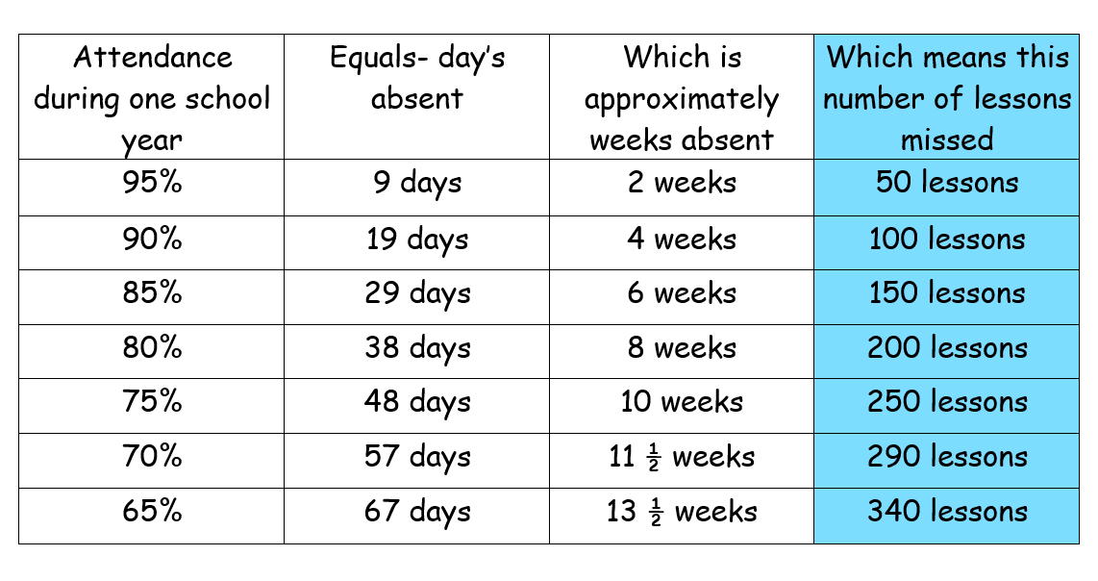

Slide 19


Slide 20
Attend Achieve Succeed #SLT Swindon Learning Together
Attendance@Swindon.gov.uk

