Slide 1



Making Data Work
Malcolm Reeve - National SEND Leader
Angela Holdsworth/ Lidia Gardner/ Nicole Dempsey – Regional SEND Leaders
Lancashire and West Yorkshire
19th November 2020

Slide 2

Agenda for the webinar:
4:00 – 4:10 Webinar Housekeeping & Introduction from LWY Regional SEND Leader
4:10 – 5:00 Making data Work
5:00 - 5:30 Q & A

Slide 3
Introduction to Whole School SEND
Aim 1
Drive education institutions to prioritise SEND within their CPD and school improvement plans including facilitating greater links between mainstream and special schools.
Aim 3
Build the skills of teachers working in mainstream and special schools and of SENCOs and teachers of classes of children and young people with sensory impairments by promoting best practice.
Aim 4
Identify and respond to any gaps in the training and resources available to schools.
Aim 2
Equip schools to identify and meet their training needs in relation to SEND.

Slide 4
Regional SEND Leadership
1 National Director
2 National SEND Leaders
16 Deputy Regional SEND Leads
8 Regional SEND Leads
8 Regions

Slide 5


Slide 6

Malcolm Reeve
National SEND leader
Accessible data expert
Experienced SEND Senior Leader/ Headteacher cross phase and sector

Slide 7
Making Data Work
(for you)
malcolm@wholeschoolsend.com
@Malcolm_Reeve

Slide 8

Disclaimer Alert
I know data isn’t for everyone.
I’m trying to make it as user friendly as possible.
This might not be as seamless as usual
Feel free to take a nap!

Slide 9
SEND Code of Practice 6.37
High quality teaching, differentiated for individual pupils, is the first step in responding to pupils who have or may have SEN
Can we expect every teacher to be a high quality teacher of SEND until every leader is a high quality leader of SEND?
Every teacher a teacher of SEND
Every leader a leader of SEND
Every governor a governor of SEND
But what does it take to be a leader of SEND?
Background reading….two articles from 2016 and 2017
https://schoolsweek.co.uk/where-are-we-now-with-special-needs/
https://www.specialneedsjungle.com/school-leadership-and-send-ignorance/

Slide 10

In the beginning….
The 6 Pillars of SEND Leadership
Know Chapter 6 of the
SEND Code of Practice
Strategic Overview
of SEND
SEND Development or
Transformation Plan
SEND Review Report
SEND in a Nutshell
Ofsted and SEND
1
2
3
4
5
6

Slide 11
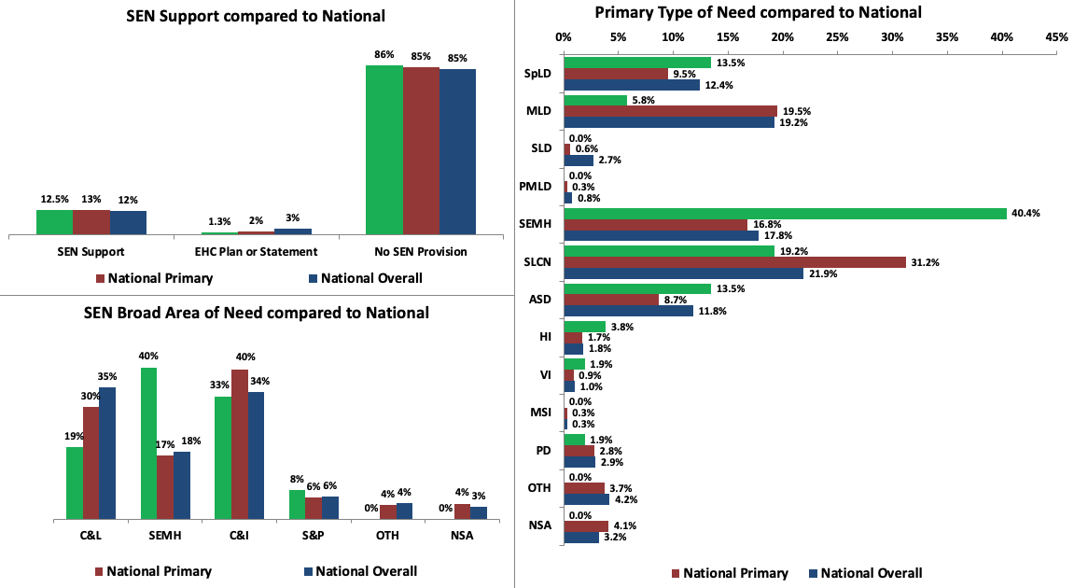
Identification (Jan 2020 census data)
High Quality Teaching and Intervention
High Quality Teaching for All
Cognition and Learning |  |  | Communication & Interaction
Social, Emotional and Mental Health |  |  | Sensory and/or Physical
Spider-Man Primary School
Absence, Exclusions, Outcomes
SEND in a Nutshell
Strengths and Areas for Development
Overall absence: % of sessions missed in primary schools
 | National No SEN | School No SEN | National SEN Support | School SEN Support | National EHCP | School EHCP
2018-19 | 3.7 | 3.6 | 5.4 | 6.3 | 7.0 | 7.8
3 ways we are supporting pupils with SEND and their families during the Covid-19 pandemic:
x
x
x
Rate of exclusions in primary schools
 | % Permanent |  |  |  |  |  | % Fixed term
 | Nat. No SEN | Sch. No SEN | Nat. SEN Supp. | Sch. SEN Supp. | Nat. EHCP | Sch. EHCP | Nat. No SEN | Sch. No SEN | Nat. SEN Supp. | Sch. SEN Supp. | Nat. EHCP | Sch. EHCP
2017-18 | 0.01 | 0.00 | 0.15 | 0.00 | 0.18 | 0.00 | 0.39 | 0.86 | 7.07 | 5.63 | 13.44 | 0.00
2018-19 | 0.00 |  | 0.12 |  | 0.18 |  | 0.38 |  | 6.90 |  | 13.61
Outcomes in primary schools
 | % EYFSP achieving GLD |  |  |  |  |  | % Y1 meeting expected standard in phonics
 | Nat. All | Sch. All | Nat. SEN Supp. | Sch. SEN Supp. | Nat. EHCP | Sch. EHCP | Nat. All | Sch. All | Nat. SEN Supp. | Sch. SEN Supp. | Nat. EHCP | Sch. EHCP
2018-19 | 72 | 79 | 29 | 50 | 5 | N/A | 82 | 81 | 48 | 57 | 20 | 33
Our 3 key strengths in SEND:
x
x
x
% Reaching exp. standard in KS1 |  |  |  | % Reaching exp. standard at KS2 |  |  |  | End of KS2 progress score
2018-19 | R | W | M | Comb. | R | W | M | R | W | M
Nat. All | 75 | 69 | 76 | 65 | 73 | 78 | 79 | 0.03 | 0.03 | 0.03
Sch. All | 66 | 66 | 77 | 78 | 81 | 83 | 83 | 1.61 | 0.87 | 1.90
Nat. SEN Supp. | 33 | 25 | 36 | 25 | 41 | 39 | 46 | -1.0 | -1.7 | -1.0
Sch. SEN Supp. | 67 | 67 | 67 | 50 | 100 | 50 | 50 | 3.01 | -2.71 | -0.88
Nat. EHCP | 13 | 9 | 14 | 9 | 16 | 14 | 17 | -3.6 | -4.3 | -4.0
Sch. EHCP | N/A | N/A | N/A | 100 | 100 | 100 | 100 | 5.69 | -0.06 | -1.09
Our 3 key areas for development for SEND:
x
x
x

Slide 12
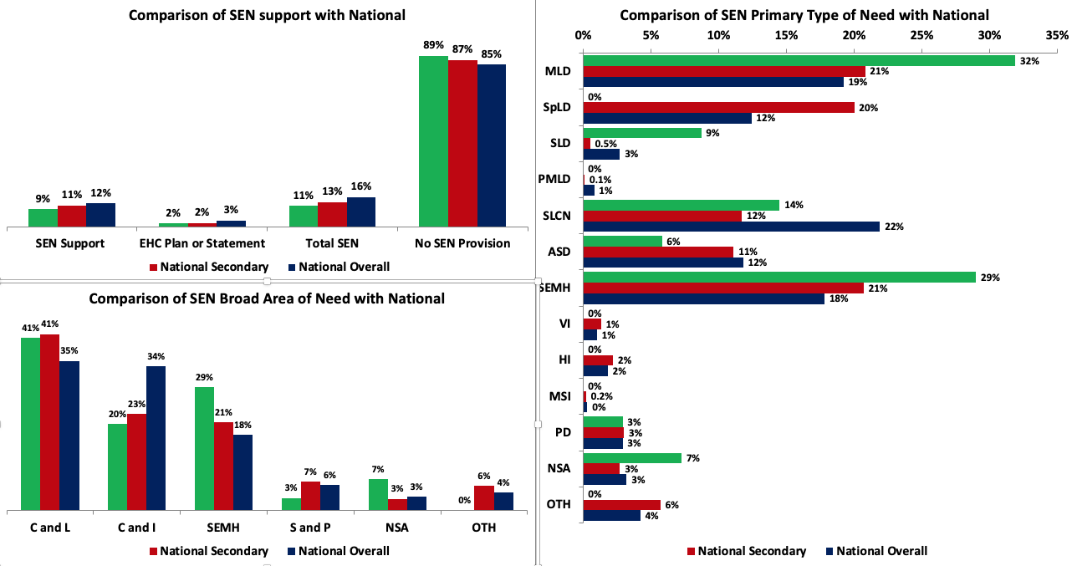
Identification (Updated September 2020)
High Quality Teaching and Intervention
Examples of High Quality Teaching for All
Examples of our Training and Expertise in SEND
Ways in which we make reasonable adjustments for pupils with SEND
Ways in which we are inspiring engagement and co-production with families
The Batman School
Absence, Exclusions, Outcomes
SEND in a Nutshell
Strengths and Areas for Development
Overall absence: % of sessions missed in secondary schools
 | National No SEN | School No SEN | National SEN Support | School SEN Support | National EHCP | School EHCP
2018-19 | 5.1 | 4.3 | 8.1 | 6.2 | 8.6 | 17.5
3 ways we are supporting pupils with SEND and their families during the Covid-19 pandemic:
x
x
x
Rate of exclusions in secondary schools
 | % Permanent |  |  |  |  |  | % Fixed term
 | Nat. No SEN | Sch. No SEN | Nat. SEN Supp. | Sch. SEN Supp. | Nat. EHCP | Sch. EHCP | Nat. No SEN | Sch. No SEN | Nat. SEN Supp. | Sch. SEN Supp. | Nat. EHCP | Sch. EHCP
2018-19 | 0.15 | 0.00 | 0.65 | 1.22 | 0.33 | 0.00 | 8.00 | 5.93 | 29.95 | 6.10 | 30.89 | 28.57
Our 3 key strengths for SEND:
x
x
x
End of KS4 outcomes
 | Attainment 8 |  |  |  |  |  | Progress 8
 | Nat. All | Sch. All | Nat. SEN Supp. | Sch. SEN Supp. | Nat. EHCP | Sch. EHCP | Nat. All | Sch. All | Nat. SEN Supp. | Sch. SEN Supp. | Nat. EHCP | Sch. EHCP
2018-19 | 46.69 | 49.95 | 32.60 | 34.83 | 13.70 | 26.38 | -0.03 | 0.04 | -0.43 | -0.56 | -1.17 | 0.14
Our 3 key areas of development for SEND:
x
x
x

Slide 13
Summary from the last session on
SEND in a Nutshell
You will receive a pdf of this presentation and the nutshell templates as powerpoint slides
Everything on the nutshell templates is editable
It is relatively straightforward to complete the right side of the nutshell
The left hand side is a bit more challenging to do but you now have a steer on where to access the data
If you’d like me to prepare your nutshell for you email me
Best wishes and hope you’ve found this helpful
Questions and discussion……………

Slide 14
No guidance
Are labels useful?
Part 1
Making identification data
work for you
A starting point for a whole school approach?
Multiple needs

Slide 15
Identification – The SEND Code of Practice
Not just the SENCO?
  6.4 School leaders and teaching staff, including the SENCO, should identify any patterns in the identification of SEN, both within the school and in comparison with national data, and use these to reflect on and reinforce the quality of teaching.
  6.5 The identification of SEN should be built into the overall approach to monitoring the progress and development of all pupils.
How might we do this?

Slide 16
Identification – The SEND Code of Practice
https://www.gov.uk/government/statistics/special-educational-needs-in-england-january-2020
(or for your January 2020 census data use the return sent by your school)

Slide 17
Identification of SEND in Primary Schools in England 2020
These are the 3 graphs you need

Slide 18
Identification of SEND in Secondary Schools in England 2020

Slide 19
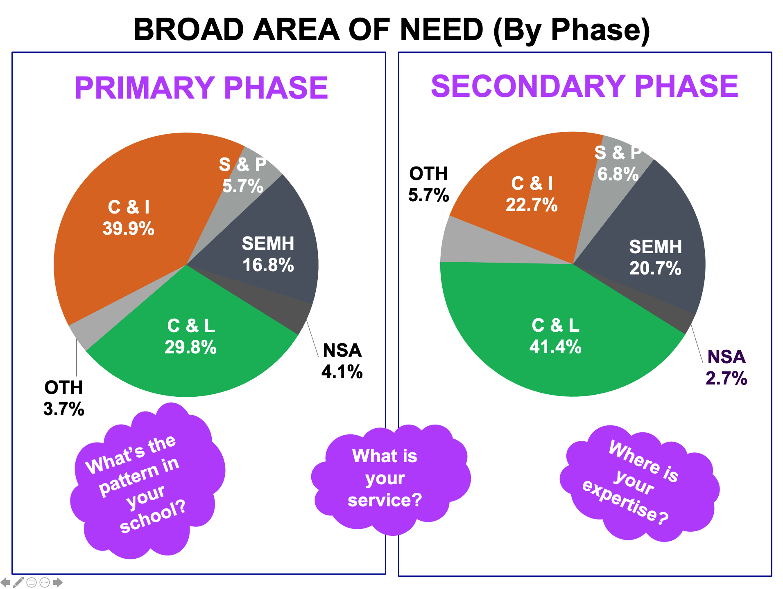

Slide 20
Here’s a strategic overview of SEND…..

Slide 21
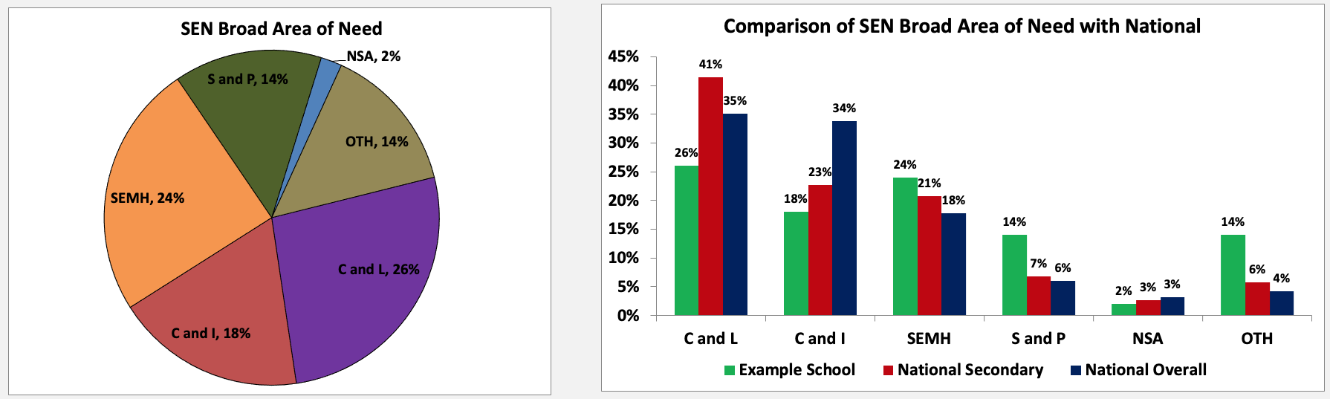
Use this to inform leadership of SEND
Use this to inform CPD and training
A starting point for discussions

Slide 22
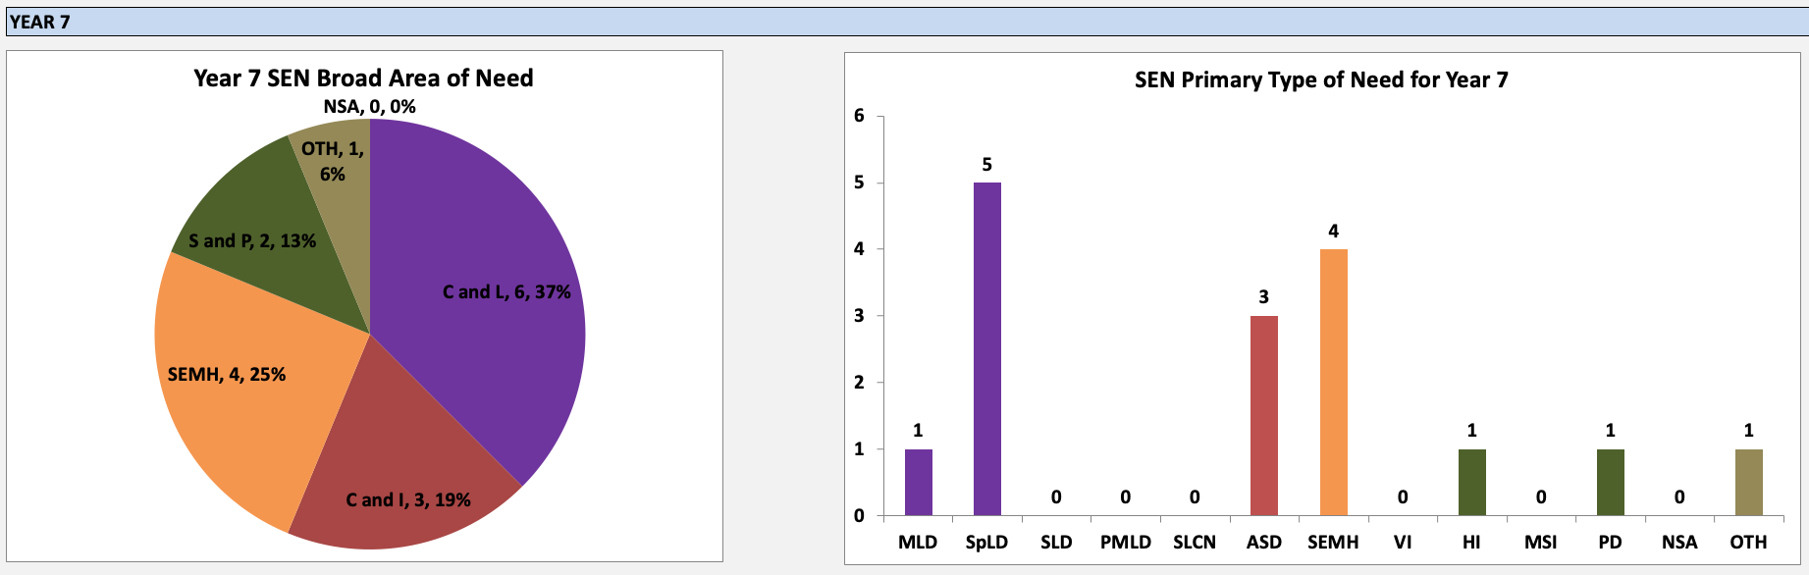
Use this to inform teaching
Use this to develop expertise

Slide 23
Why are these the key metrics?
absence
Part 2
Making
absence, exclusions, progress/outcomes
data work for you
Progress and outcomes
exclusions

Slide 24

  Pupils with SEND in mainstream schools can also struggle to access good-quality education.
  over five times more likely to have a fixed-term exclusion
  five times more likely to be permanently excluded from state-funded primary and secondary schools.
  pupils with SEND account for over 178,000 (43%) of fixed-term and nearly 3,600 (45%) of permanent exclusions in 2017/18.
  Para.237

Slide 25
SEND Data – The National Data sets
https://assets.publishing.service.gov.uk/government/uploads/system/uploads/attachment_data/file/882802/Special_educational_needs_and_disability_-_an_analysis_and_summary_of_data_sources.pdf
If you need a nap – take it now!

Slide 26
Finding SEND Absence and Exclusions Data
in The National Data sets
Absence in primary and secondary schools https://www.gov.uk/government/statistics/pupil-absence-in-schools-in-england-2018-to-2019 = National and local authority tables>Table 5.1
Primary and secondary exclusions https://explore-education-statistics.service.gov.uk/find-statistics/permanent-and-fixed-period-exclusions-in-england = Permanent and fixed term exclusions national tables>Table 5

Slide 27
Finding EYFSP, Y1 Phonics, KS1 and KS2
SEND Data
in The National Data sets
EYFSP % Achieving GLD https://www.gov.uk/government/statistics/early-years-foundation-stage-profile-results-2018-to-2019 = EYFS Profile results 2018-19>EYFSP Tables>Pupil Characteristics 2019>Table 1
Y1 Phonics % Achieving Expected https://www.gov.uk/government/statistics/phonics-screening-check-and-key-stage-1-assessments-england-2019 = Phonics Screening Check & KS 1 Attainment>Phonics Tables>Table N2
KS1 % reaching expected standard https://www.gov.uk/government/statistics/phonics-screening-check-and-key-stage-1-assessments-england-2019 = Key Stage 1 tables>Table N10
KS2 % reaching expected standard https://www.gov.uk/government/statistics/national-curriculum-assessments-key-stage-2-2019-revised = National, local authority and regional tables>Table N4a

Slide 28
Finding KS4 SEND Outcomes Data
in The National Data sets
KS4 Outcomes https://www.gov.uk/government/statistics/key-stage-4-performance-2019-revised = National characteristics tables>Table CH1

Slide 29
EYFSP % Achieving GLD https://www.gov.uk/government/statistics/early-years-foundation-stage-profile-results-2018-to-2019 = EYFS Profile results 2018-19>EYFSP Tables>Pupil Characteristics 2019>Table 1
Y1 Phonics % Achieving Expected https://www.gov.uk/government/statistics/phonics-screening-check-and-key-stage-1-assessments-england-2019 = Phonics Screening Check & KS 1 Attainment>Phonics Tables>Table N2
KS1 % reaching expected standard https://www.gov.uk/government/statistics/phonics-screening-check-and-key-stage-1-assessments-england-2019 = Key Stage 1 tables>Table N10
KS2 % reaching expected standard https://www.gov.uk/government/statistics/national-curriculum-assessments-key-stage-2-2019-revised = National, local authority and regional tables>Table N4a

Slide 30
Analyse School Performance (ASP)
Replaced Raise online
Use together with the school’s Inspection Data Summary Report (IDSR)
Analyse School Performance has more SEND information
Your Headteacher has a log-in code or can give you a pdf
Updates are issued through the year – the most recent on Exclusions and Absence

Slide 31
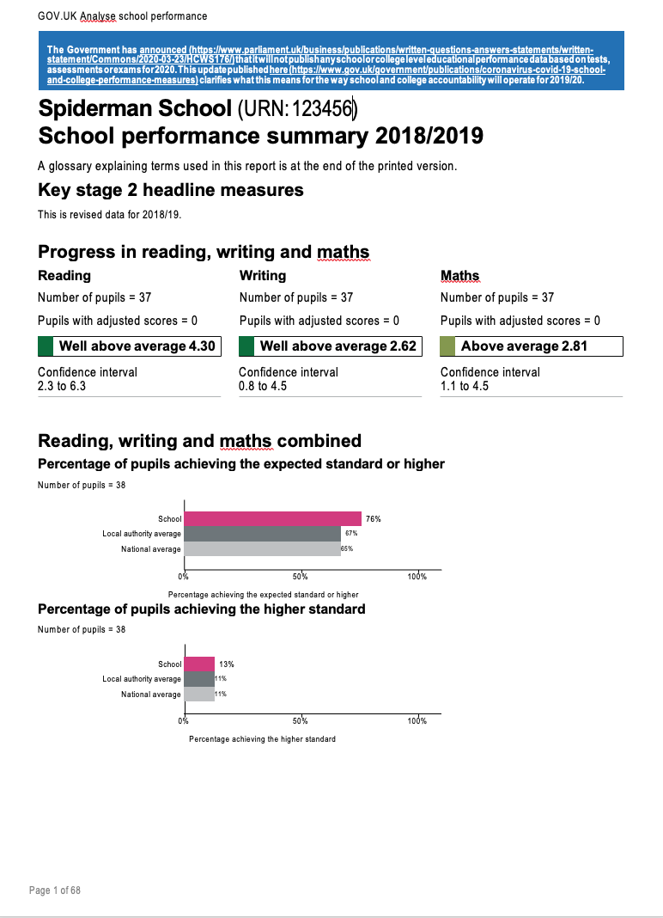


Slide 32
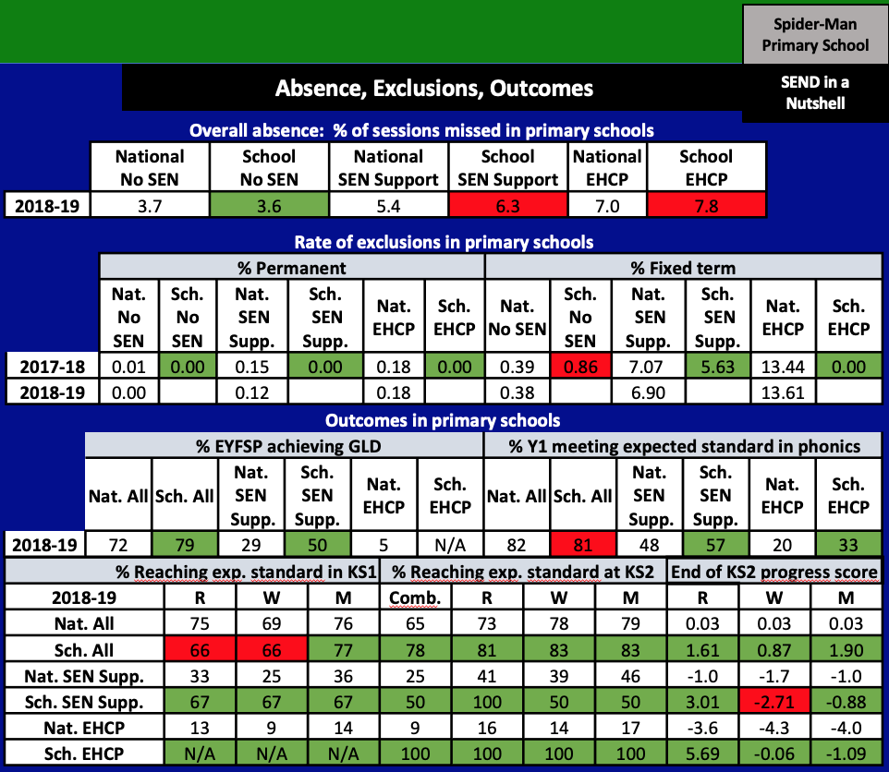
How can we reduce absence for SEN Support and EHCP
Exclusions for SEND looking ok
Progress/outcomes for SEND looking good
But writing for children on SEN Support?

Slide 33
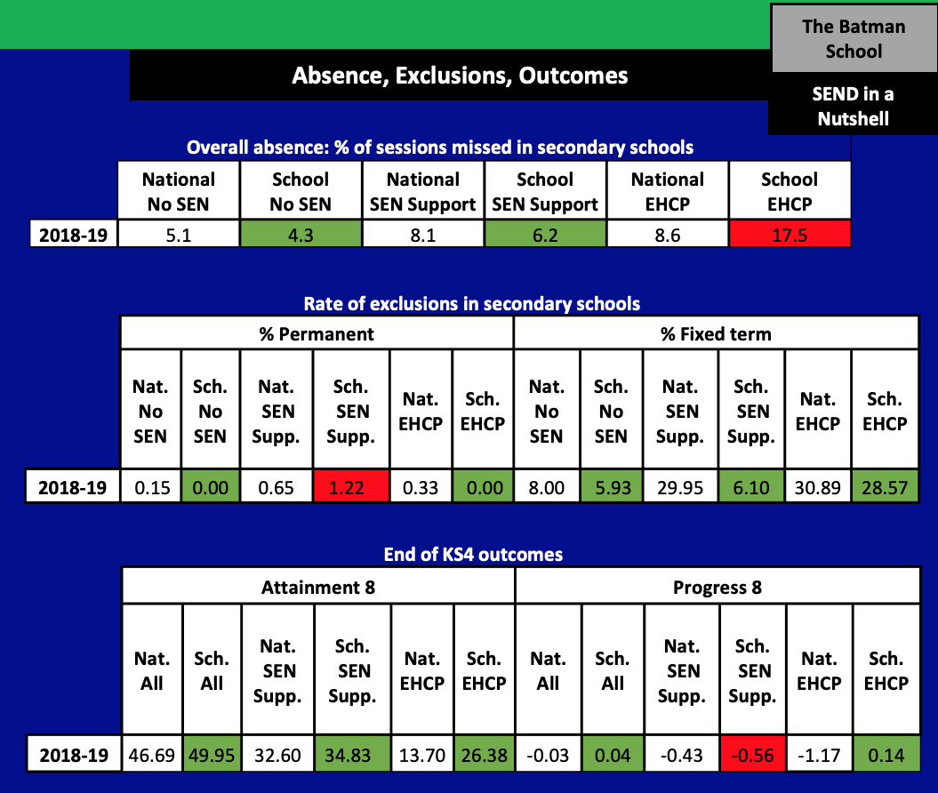
3 actions…..
Need to reduce absence for EHCP students
Permament exclusions for SEN Support
Progress 8 for SEN Support

Slide 34
Progress is different for every child with SEND
We’re talking about human beings!
Part 3
Articulating the progress of children with SEND
Reward the effort and progress which children with SEND make
Keep your eye on the end game

Slide 35
A 3-fold model for the progress of a child with SEND
Absence, Exclusions and Behaviour and Attitudes to Learning
Progress against support plan targets / EHCP outcomes
Attainment and Progress against ‘age-related’ outcomes
This is through the lens of the prior pupil pattern of absence, exclusion and introduces behaviour and attitudes to learning
This is the national data we have just covered
This is the national data we have just covered

Slide 36
Questions/discussion on all of the above
Making Data Work
for you
malcolm@wholeschoolsend.com
@Malcolm_Reeve

Slide 37
Regional Contact Information
Angela Holdsworth – RSL Email: RSL.LWY@wholeschoolsend.com
Lidia Gardner - DRSL Email: RSL.LWY@wholeschoolsend.com
Nicole Dempsey – DRSL Email: DRSL2.LWY@wholeschoolsend.com
Contact us on Twitter: @WSSLancsWY

